Slide 1

CLASS 8 CD-404 Data Collection and Data Pre-Processing UNIT 2
Data Collection and Data Pre-Processing
Prof. Vineeta Shrivastava
Assistant Professor
Department of Computer Science & Engineering
LNCT-E, Bhopal
Lakshmi Narain College of Technology Excellence, Bhopal

Slide 2
CLASS 8 CD-404 Data Collection and Data Pre-Processing UNIT 2
AGENDA
Data Preprocessing: An Overview
Data Quality
Major Tasks in Data Preprocessing
Data Cleaning
Data Integration
Data Reduction
Data Transformation and Data Discretization
Prof. Vineeta Shrivastava
Assistant Professor
Department of Computer Science & Engineering
LNCT-E, Bhopal
Lakshmi Narain College of Technology Excellence, Bhopal

Slide 3
CLASS 8 CD-404 Data Collection and Data Pre-Processing UNIT 2
Data Pre-processing: An Overview
Prof. Vineeta Shrivastava
Assistant Professor
Department of Computer Science & Engineering
LNCT-E, Bhopal
Lakshmi Narain College of Technology Excellence, Bhopal

Slide 4
CLASS 8 CD-404 Data Collection and Data Pre-Processing UNIT 2
What is data pre-processing ??
Data
Audio
Text
Video
Image
Data Pre-processing is a technique to convert raw data into meaning full data by using some different techniques.
Why Data Pre-processing is important?
Data in real world is dirty.
Incomplete
Inconsistent
Noisy
Duplicate
Quality data Elements
Accuracy
Completeness
Consistency
Believability
Availability
Prof. Vineeta Shrivastava
Assistant Professor
Department of Computer Science & Engineering
LNCT-E, Bhopal
Lakshmi Narain College of Technology Excellence, Bhopal

Slide 5
CLASS 8 CD-404 Data Collection and Data Pre-Processing UNIT 2
Data Pre-processing for ML
Data pre-processing is the processing of preparing the data and making it suitable for a ML model.
A quality of data affects the ability of model to learn , hence it is extremely important that we process data before giving as input to model.
Prof. Vineeta Shrivastava
Assistant Professor
Department of Computer Science & Engineering
LNCT-E, Bhopal
Lakshmi Narain College of Technology Excellence, Bhopal

Slide 6
CLASS 8 CD-404 Data Collection and Data Pre-Processing UNIT 2
Data Pre-processing for ML
Whenever data is generated from different sources it is collected in raw format which is not suitable for analysis. So data pre-processing is a technique that is used to convert the raw data into a clean dataset.
Data in raw format contains noises, missing values, not in usable format.
Data pre-processing cleans the data and make it suitable for ML model which also increases the accuracy and efficiency of a ML model.
Prof. Vineeta Shrivastava
Assistant Professor
Department of Computer Science & Engineering
LNCT-E, Bhopal
Lakshmi Narain College of Technology Excellence, Bhopal

Slide 7
CLASS 8 CD-404 Data Collection and Data Pre-Processing UNIT 2
Data Quality: Why Preprocess the Data?
Measures for data quality: A multidimensional view
Accuracy:
Completeness:
Consistency:
Timeliness:
Believability:
Interpretability:
Prof. Vineeta Shrivastava
Assistant Professor
Department of Computer Science & Engineering
LNCT-E, Bhopal
Lakshmi Narain College of Technology Excellence, Bhopal

Slide 8
CLASS 8 CD-404 Data Collection and Data Pre-Processing UNIT 2
Major Tasks in Data Preprocessing
Data collection
Collect data from different sources
Data cleaning
Fill in missing values, smooth noisy data, identify or remove outliers, and resolve inconsistencies
Data integration
Integration of multiple databases or files
Data reduction
Dimensionality reduction
Data compression
Data transformation and data discretization
Normalization
Concept hierarchy generation
Prof. Vineeta Shrivastava
Assistant Professor
Department of Computer Science & Engineering
LNCT-E, Bhopal
Lakshmi Narain College of Technology Excellence, Bhopal

Slide 9
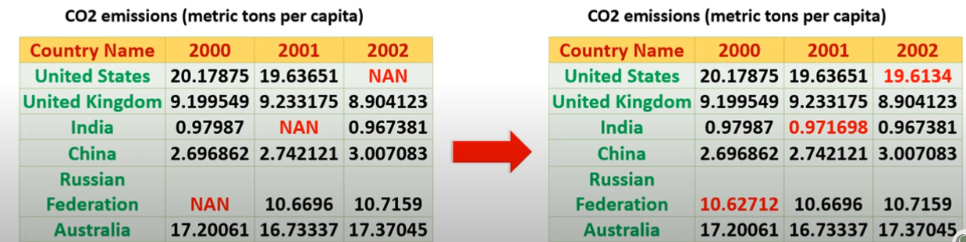
CLASS 8 CD-404 Data Collection and Data Pre-Processing UNIT 2
What is data cleaning?
Data cleaning means fill in missing values, smooth out noise while identifying outliers and correct inconsistency in data.
Prof. Vineeta Shrivastava
Assistant Professor
Department of Computer Science & Engineering
LNCT-E, Bhopal
Lakshmi Narain College of Technology Excellence, Bhopal

Slide 10
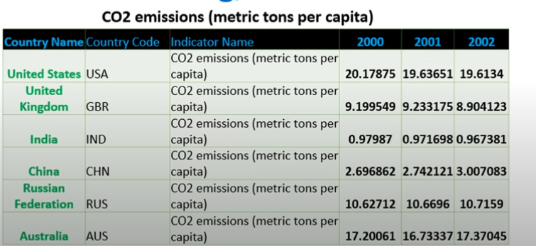
CLASS 8 CD-404 Data Collection and Data Pre-Processing UNIT 2
What is data integration ?
Data integration is a technique to merges data from multiple sources into a coherent data store, such as data warehousing.
Prof. Vineeta Shrivastava
Assistant Professor
Department of Computer Science & Engineering
LNCT-E, Bhopal
Lakshmi Narain College of Technology Excellence, Bhopal

Slide 11
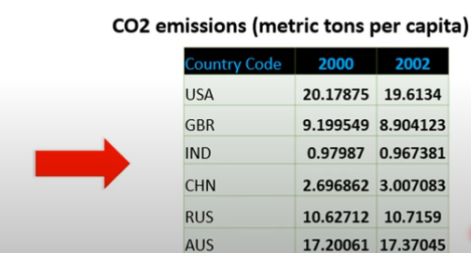
CLASS 8 CD-404 Data Collection and Data Pre-Processing UNIT 2
What is data Reduction ?
Data reduction is a technique to reduce the data size by aggregating, eliminating redundant features, or clustering.
Prof. Vineeta Shrivastava
Assistant Professor
Department of Computer Science & Engineering
LNCT-E, Bhopal
Lakshmi Narain College of Technology Excellence, Bhopal

Slide 12
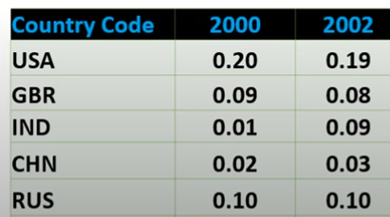
CLASS 8 CD-404 Data Collection and Data Pre-Processing UNIT 2
What is data transformation?
Data transformation means data are transformed or consolidated into forms appropriate for ML model training, such as normalization, may be applied where data are scaled to fall with in a smaller range like 0.0 and 1.0
Aggregation
Feature type conversion
Normalization
Attribute/feature construction.
Prof. Vineeta Shrivastava
Assistant Professor
Department of Computer Science & Engineering
LNCT-E, Bhopal
Lakshmi Narain College of Technology Excellence, Bhopal

Slide 13
CLASS 8 CD-404 Data Collection and Data Pre-Processing UNIT 2
What is data discretization?
Data discretization technique transforms the numeric data by mapping values to interval or concept labels.
It can be used to reduce the number of values for a given continuous attribute by dividing the range of attributes into intervals.
Data discretization technique include-
Histogram analysis
Cluster analysis
Decision tree analysis
Correlation analysis
Age:1,2,3,4,5,6,7,8,9
Output:1-3,4-6,7-9
Prof. Vineeta Shrivastava
Assistant Professor
Department of Computer Science & Engineering
LNCT-E, Bhopal
Lakshmi Narain College of Technology Excellence, Bhopal

Slide 14
CLASS 8 CD-404 Data Collection and Data Pre-Processing UNIT 2
Step 1:Data Collection
Prof. Vineeta Shrivastava
Assistant Professor
Department of Computer Science & Engineering
LNCT-E, Bhopal
Lakshmi Narain College of Technology Excellence, Bhopal

Slide 15
CLASS 8 CD-404 Data Collection and Data Pre-Processing UNIT 2
Step 1:-Data Collection
This step involves gathering data from various sources such as databases, files and external repositories. Before starting the data collection process, first we have to find out the problem solved by ML model.
Knowing the objective to achieve by algorithm will assist in determining the type of data required.
Also it helps in getting a clear picture of all data available, required and missing.
Prof. Vineeta Shrivastava
Assistant Professor
Department of Computer Science & Engineering
LNCT-E, Bhopal
Lakshmi Narain College of Technology Excellence, Bhopal

Slide 16
CLASS 8 CD-404 Data Collection and Data Pre-Processing UNIT 2
The process of gathering and analyzing accurate data from various sources to find answers to research problems, trends and probabilities, etc., to evaluate possible outcomes is Known as Data Collection.
Data collection is the process of collecting and evaluating information or data from multiple sources to find answers to research problems, answer questions, evaluate outcomes, and forecast trends and probabilities.
Prof. Vineeta Shrivastava
Assistant Professor
Department of Computer Science & Engineering
LNCT-E, Bhopal
Lakshmi Narain College of Technology Excellence, Bhopal

Slide 17
CLASS 8 CD-404 Data Collection and Data Pre-Processing UNIT 2
Before an analyst begins collecting data, they must answer three questions first:
What’s the goal or purpose of this research?
What kinds of data are they planning on gathering?
What methods and procedures will be used to collect, store, and process the information?
Prof. Vineeta Shrivastava
Assistant Professor
Department of Computer Science & Engineering
LNCT-E, Bhopal
Lakshmi Narain College of Technology Excellence, Bhopal

Slide 18
CLASS 8 CD-404 Data Collection and Data Pre-Processing UNIT 2
Different Data Collection Methods
Primary and secondary methods of data collection are two approaches used to gather information for research or analysis purposes.
Primary data collection involves the collection of original data directly from the source or through direct interaction with the respondents.
Prof. Vineeta Shrivastava
Assistant Professor
Department of Computer Science & Engineering
LNCT-E, Bhopal
Lakshmi Narain College of Technology Excellence, Bhopal

Slide 19
CLASS 8 CD-404 Data Collection and Data Pre-Processing UNIT 2
Various techniques for primary data collection, including:
Surveys and Questionnaires
Interviews
Observations
Experiments
Focus Groups
Prof. Vineeta Shrivastava
Assistant Professor
Department of Computer Science & Engineering
LNCT-E, Bhopal
Lakshmi Narain College of Technology Excellence, Bhopal

Slide 20
CLASS 8 CD-404 Data Collection and Data Pre-Processing UNIT 2
Secondary Data Collection:
Secondary data collection involves using existing data collected by someone else for a purpose different from the original intent.
Researchers analyze and interpret this data to extract relevant information.
Prof. Vineeta Shrivastava
Assistant Professor
Department of Computer Science & Engineering
LNCT-E, Bhopal
Lakshmi Narain College of Technology Excellence, Bhopal

Slide 21
CLASS 8 CD-404 Data Collection and Data Pre-Processing UNIT 2
Secondary data can be obtained from various sources, including:
Published Sources
Online Databases:
Government and Institutional Records
Publicly Available Data
Past Research Studies
Prof. Vineeta Shrivastava
Assistant Professor
Department of Computer Science & Engineering
LNCT-E, Bhopal
Lakshmi Narain College of Technology Excellence, Bhopal

Slide 22
CLASS 8 CD-404 Data Collection and Data Pre-Processing UNIT 2
Data Collection Tools
Social Media Listening Tool (hootshoot and sprout)
Web Analytics Tools
Data Logging Devices
Mobile Data Collection Apps
IoT Platforms
Prof. Vineeta Shrivastava
Assistant Professor
Department of Computer Science & Engineering
LNCT-E, Bhopal
Lakshmi Narain College of Technology Excellence, Bhopal

Slide 23
CLASS 8 CD-404 Data Collection and Data Pre-Processing UNIT 2
Data Agumentation
Prof. Vineeta Shrivastava
Assistant Professor
Department of Computer Science & Engineering
LNCT-E, Bhopal
Lakshmi Narain College of Technology Excellence, Bhopal

Slide 24
CLASS 8 CD-404 Data Collection and Data Pre-Processing UNIT 2
Data Augmentation (A method of data collection)
In some cases, data augmentation might be required to expand the size of existing dataset without gathering more data.
If we have more data, the better will be our ML model. But every data collection process is associated with a cost.
This cost may be in terms of dollars, human efforts, computational resources and time consumed in the process.
Therefore we may need to augment existing data to increase the data size that we feed to our ML model.
Prof. Vineeta Shrivastava
Assistant Professor
Department of Computer Science & Engineering
LNCT-E, Bhopal
Lakshmi Narain College of Technology Excellence, Bhopal

Slide 25
CLASS 8 CD-404 Data Collection and Data Pre-Processing UNIT 2
Data Augmentation (A method of data collection)
For example if a dataset of images are collected they can be augmented by
Rotating the original image
Crop the original image differently
Altering the light condition
So for one image you can generate different sub samples
Prof. Vineeta Shrivastava
Assistant Professor
Department of Computer Science & Engineering
LNCT-E, Bhopal
Lakshmi Narain College of Technology Excellence, Bhopal

Slide 26
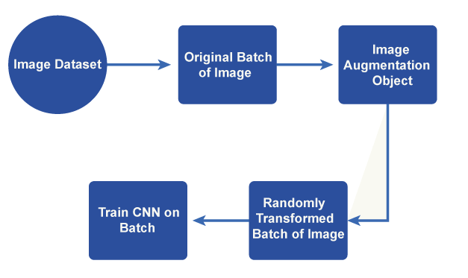
Fi
CLASS 8 CD-404 Data Collection and Data Pre-Processing UNIT 2
Fig 1: data augmentation
Prof. Vineeta Shrivastava
Assistant Professor
Department of Computer Science & Engineering
LNCT-E, Bhopal
Lakshmi Narain College of Technology Excellence, Bhopal

Slide 27
CLASS 8 CD-404 Data Collection and Data Pre-Processing UNIT 2
Techniques for data augmentation can be used with a variety of data, including time series, text, photos, and audio.
Images can be rotated at different angles and flipped horizontally or vertically to create alternative points of view.
Random cropping and padding
Scaling and zooming
Shearing and perspective transform
Colour segmentation
Gaussian noise
Prof. Vineeta Shrivastava
Assistant Professor
Department of Computer Science & Engineering
LNCT-E, Bhopal
Lakshmi Narain College of Technology Excellence, Bhopal

Slide 28
CLASS 8 CD-404 Data Collection and Data Pre-Processing UNIT 2
Types of Data Augmentations
Real Data Augmentation
Synthetic Data Augmentation
Prof. Vineeta Shrivastava
Assistant Professor
Department of Computer Science & Engineering
LNCT-E, Bhopal
Lakshmi Narain College of Technology Excellence, Bhopal

Slide 29
CLASS 8 CD-404 Data Collection and Data Pre-Processing UNIT 2
Real Data Augmentation
The process of modifying real-world data samples to enhance the base of training for artificial intelligence models is referred to as "real data augmentation."
Real data augmentation, as compared to synthetic data augmentation produces new samples based on existing data and also modifies the original data in a way that accurately removes fluctuations and disturbances that occur in the real world.
Prof. Vineeta Shrivastava
Assistant Professor
Department of Computer Science & Engineering
LNCT-E, Bhopal
Lakshmi Narain College of Technology Excellence, Bhopal

Slide 30
CLASS 8 CD-404 Data Collection and Data Pre-Processing UNIT 2
Real Data augmentation approaches as examples:
Sensor noise
Occlusion
Weather
Time series
Label smoothing
Prof. Vineeta Shrivastava
Assistant Professor
Department of Computer Science & Engineering
LNCT-E, Bhopal
Lakshmi Narain College of Technology Excellence, Bhopal

Slide 31
CLASS 8 CD-404 Data Collection and Data Pre-Processing UNIT 2
Synthetic Data Augmentation
In machine learning, synthetic data augmentation creates additional artificial data samples based on current data to increase the training set.
It is a method for broadening the variety and volume of data accessible for model training.
When a dataset is not in large quantity or more variations are required to boost a model's performance, synthetic data augmentation can be especially helpful.
Prof. Vineeta Shrivastava
Assistant Professor
Department of Computer Science & Engineering
LNCT-E, Bhopal
Lakshmi Narain College of Technology Excellence, Bhopal

Slide 32
CLASS 8 CD-404 Data Collection and Data Pre-Processing UNIT 2
Synthetic Data augmentation approaches as examples
Image synthesis
Text generation
Oversampling and undersampling
Data interpolation and extrapolation
Feature perturbation
Prof. Vineeta Shrivastava
Assistant Professor
Department of Computer Science & Engineering
LNCT-E, Bhopal
Lakshmi Narain College of Technology Excellence, Bhopal

Slide 33
CLASS 8 CD-404 Data Collection and Data Pre-Processing UNIT 2
Challenges Faced by Data Augmentation
Maintaining label integrity
Excessive or incorrect data augmentation can result in overfitting
Data augmentation can dramatically increase the size of the training dataset
Data security and privacy
Interpretability and explain ability
Prof. Vineeta Shrivastava
Assistant Professor
Department of Computer Science & Engineering
LNCT-E, Bhopal
Lakshmi Narain College of Technology Excellence, Bhopal

Slide 34
CLASS 8 CD-404 Data Collection and Data Pre-Processing UNIT 2
Data Labelling
Prof. Vineeta Shrivastava
Assistant Professor
Department of Computer Science & Engineering
LNCT-E, Bhopal
Lakshmi Narain College of Technology Excellence, Bhopal

Slide 35
CLASS 8 CD-404 Data Collection and Data Pre-Processing UNIT 2
Data Labelling
Data labelling in supervised ML models, might be also a part of data preparation process.
It can be done manually by crowd workers or automatically using specialized framework.
Data pre-processing
As the data collected in steps1 may be in undesired format, unorganized or extremely large so further steps are needed to enhance the quality of data.
Prof. Vineeta Shrivastava
Assistant Professor
Department of Computer Science & Engineering
LNCT-E, Bhopal
Lakshmi Narain College of Technology Excellence, Bhopal

Slide 36
CLASS 8 CD-404 Data Collection and Data Pre-Processing UNIT 2
Data Labelling
Data labeling is the way of identifying the raw data and adding suitable labels or tags to that data to specify what this data is about, which allows ML models to make an accurate prediction.
Prof. Vineeta Shrivastava
Assistant Professor
Department of Computer Science & Engineering
LNCT-E, Bhopal
Lakshmi Narain College of Technology Excellence, Bhopal

Slide 37
CLASS 8 CD-404 Data Collection and Data Pre-Processing UNIT 2
Labeled Data vs. Unlabelled Data
Labeled data is data that has some predefined tags such as name, type, or number. For example, an image has an apple or banana. At the same time, unlabelled data contains no tags or no specified name.
Labeled data is used in Supervised Learning techniques, whereas Unlabelled data is used in Unsupervised Learning.
Labeled data is difficult to get, whereas Unalabled data is easy to acquire.
Prof. Vineeta Shrivastava
Assistant Professor
Department of Computer Science & Engineering
LNCT-E, Bhopal
Lakshmi Narain College of Technology Excellence, Bhopal

Slide 38
CLASS 8 CD-404 Data Collection and Data Pre-Processing UNIT 2
Approaches to Data Labelling
Internal/In-house data labelling
Synthetic Labeling
Programmatic Labeling
Outsourcing
Crowdsourcing
Prof. Vineeta Shrivastava
Assistant Professor
Department of Computer Science & Engineering
LNCT-E, Bhopal
Lakshmi Narain College of Technology Excellence, Bhopal

Slide 39
CLASS 8 CD-404 Data Collection and Data Pre-Processing UNIT 2
Benefits and Challenges of Data Labelling
Benefits
Precise Predictions
Better Data Usability
Challenges
Costly and time-consuming
Possibilities of Human-Error
Prof. Vineeta Shrivastava
Assistant Professor
Department of Computer Science & Engineering
LNCT-E, Bhopal
Lakshmi Narain College of Technology Excellence, Bhopal

Slide 40
CLASS 8 CD-404 Data Collection and Data Pre-Processing UNIT 2
THANKYOU
Prof. Vineeta Shrivastava
Assistant Professor
Department of Computer Science & Engineering
LNCT-E, Bhopal
Lakshmi Narain College of Technology Excellence, Bhopal

